Slide 1
Intro to Phylogenetic Analyses

Slide 2
Outline
Review: phylogenetic trees and applications for genomic epidemiology
From sequences to trees
  Highlighting methods used
Interpreting phylogenetic trees
  Terms
  Divergent trees and time trees
Common phylogenetic tree misinterpretations

Slide 3
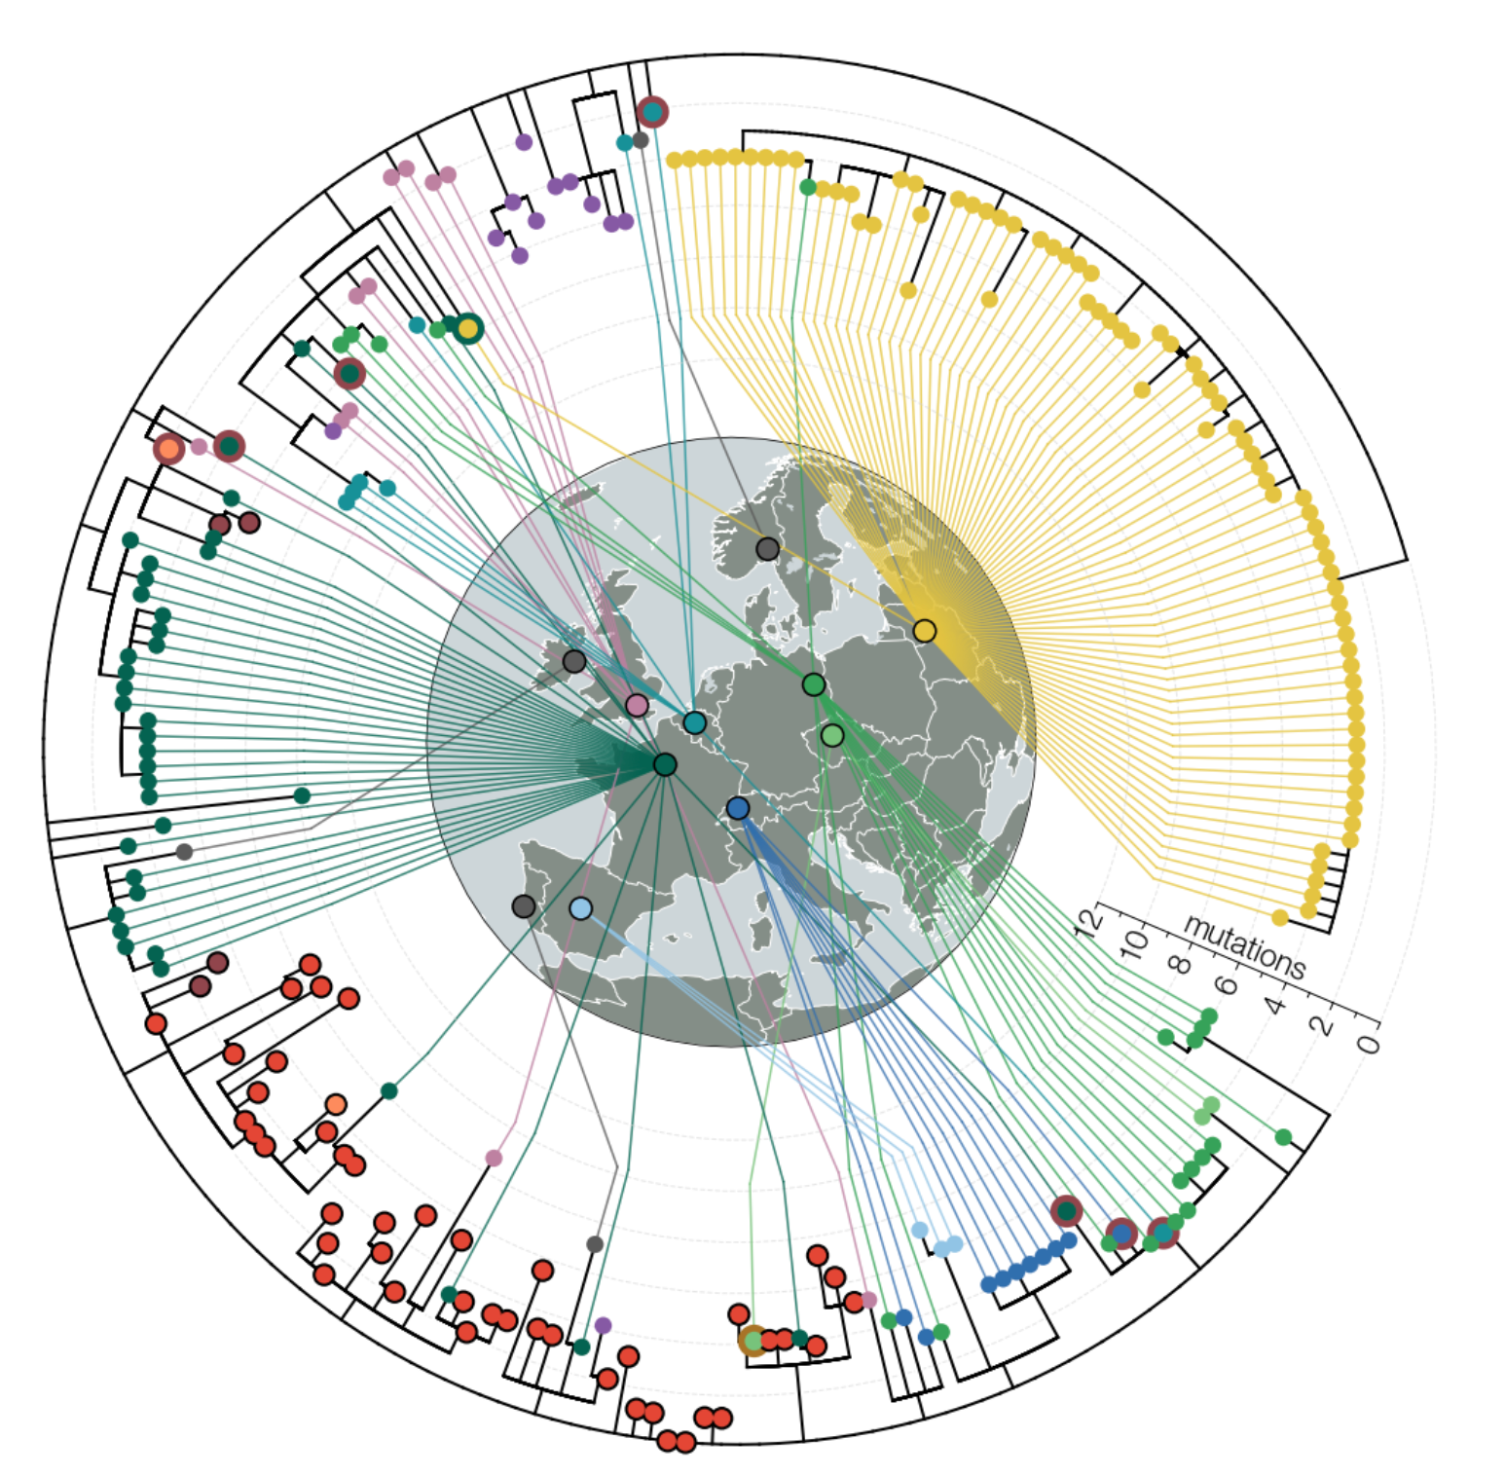
Phylogenetic trees are hierarchical diagrams that describe relationships between organisms
Specifically, phylogenetic analyses are hypotheses of common descent, whereby sequences that have seemingly inherited the same mutations will cluster together.
Image Source: https://alliblk.github.io/genepi-book/index.html
Notes:
an estimate of the relationships among taxa (or sequences) and their hypothetical common ancestors

Slide 4
Phylogenetic trees help us to…
understand the relationships among the sequences,
identify sources and sinks using phylogeography,
estimate the start and stop of an outbreak,
rule-out epi-linkages in an outbreak,
identify emerging lineages,
And so many more!

Slide 5
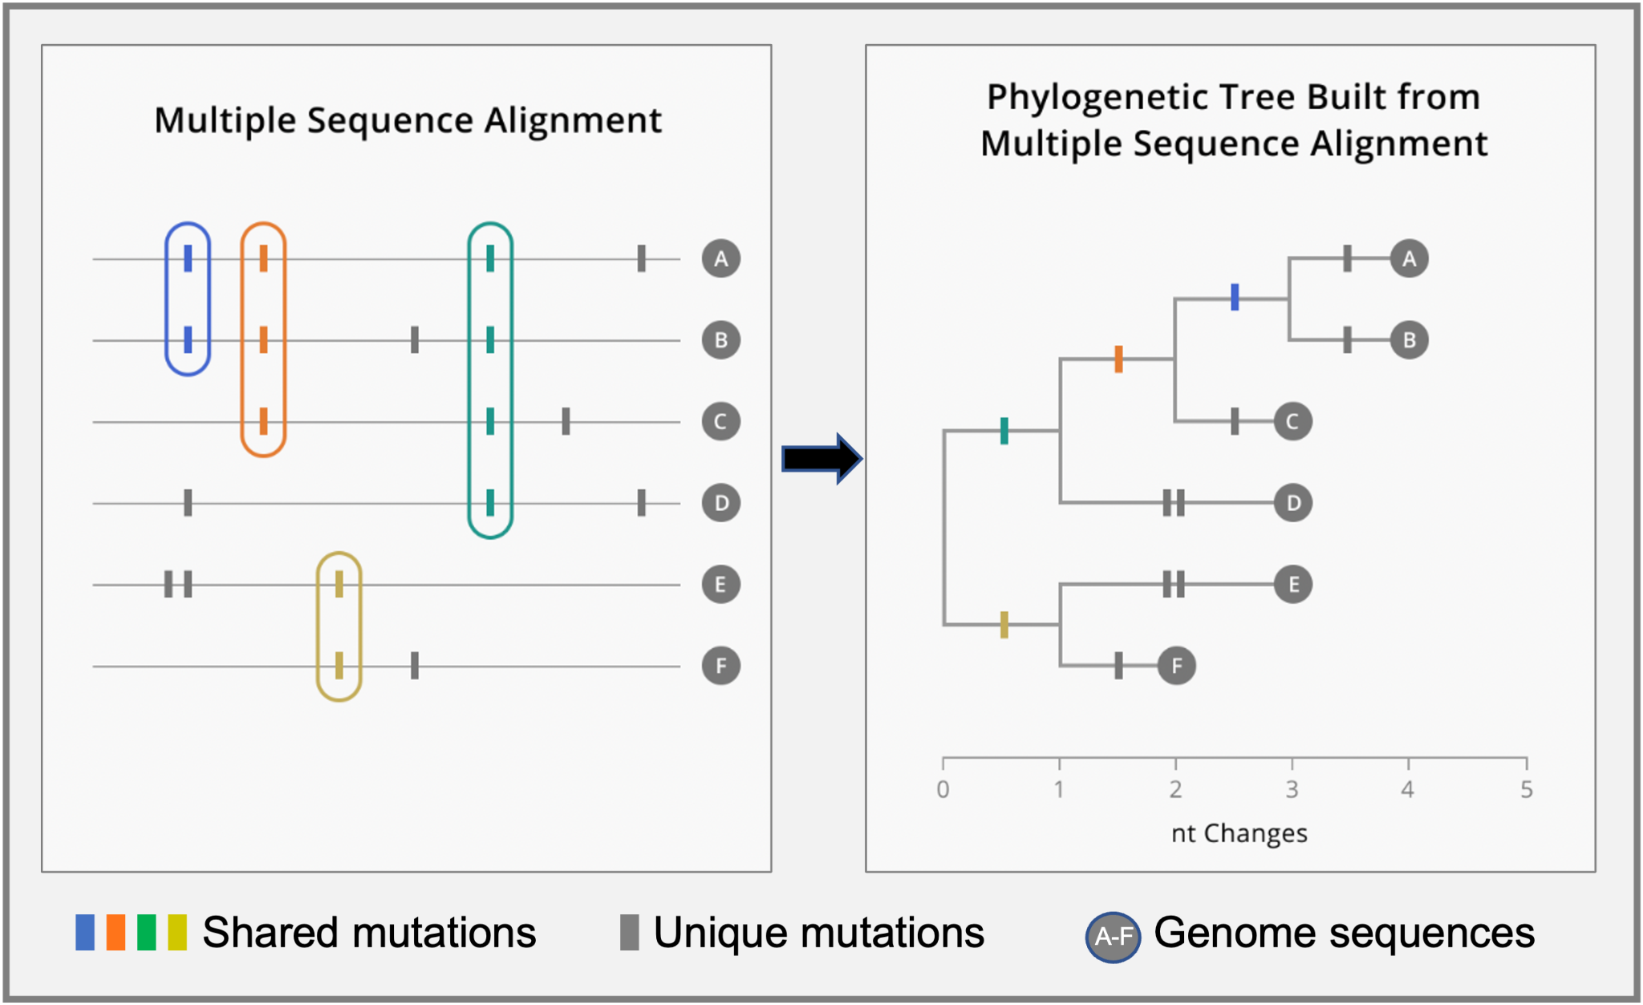
From sequences to a tree
Source: https://alliblk.github.io/genepi-book/index.html
Notes:
When first generated, consensus genomes from different samples will be of different lengths and will have different numbers of sites where the precise nucleotide is known.
To make sure that we are comparing the same sites in the genome across all of the sequences in our data set, we must perform a multiple sequence alignment.
When your sequences are all aligned, you can start to see patterns of shared and unique genetic changes. This pattern of shared genetic changes and unique mutations within a sequence is the information that we will encode in the phylogenetic tree.
We build phylogenetic trees by hierarchically clustering sequences according to which mutations they share. When a mutation occurs on a branch, all the samples that descend from that branch will carry that mutation.
Mutations that occur earlier in the tree are inherited by more samples.
Mutations that occur on a terminal branch, or a branch leading to only one sample, are unique to that genome sequence

Slide 6
Steps in a phylogenetic analysis
Determine your research question,
Identify and acquire a set of homologous sequences (include a reference sequence, focal sequences, and contextual sequences),
Perform multiple sequence alignment,
Estimate a tree from the aligned sequences using a statistical method,
Assess the reliability of a tree,
Interpret your tree and present findings to policy makers (if relevant) or add to publication to help convey results
Notes:
Step 1 Outlining your research question is important for figuring out the type of tree you need (i.e. time tree or regular divergent tree) and the samples necessary to include.
Step 2 is the most important. If not done well, the tree will be invalid or impossible to interpret or both. If done wisely, the remaining steps are easy, essentially mechanical, operations that will result in a robust meaningful tree. The most basic assumption of phylogenetic analysis is that all the sequences on a tree are homologous, that is, descended from a common ancestor. Alignment programs will align sequences, homologous or not. All tree-building programs will make a tree from that alignment. However, if the sequences are not actually descended from a common ancestor, the tree will be meaningless and may quite well be misleading. The most reliable way to identify sequences that are homologous to the sequence of interest is to do a Basic Local Alignment Search Tool (BLAST) search (Altschul et al. 1997) using the sequence of interest as a query.
Step 3 (covered in previous lectures so skip) is to align those sequences. it is highly recommended to inspect alignments by eye, with highlighting of sites that are different from a reference or consensus of the entire alignment. Sections of sequences that are misaligned, contain sequencing or assembly errors will be very easy to spot this way. Get into the habit of going back to your multiple sequence alignments every time you see particularly long branches or sequences that seem out of place in phylogenetic trees. Once the alignment is complete, you will see that gaps have been introduced into the sequences. Those gaps represent historical insertions or deletions, and their purpose is to bring homologous sites into alignment in the same column. It should be appreciated that just as a phylogenetic tree is an “estimate” of relationships among sequences, an alignment is just an estimate of the positions of historical insertions and deletions. The quality of the alignment can affect the quality of a phylogenetic tree.
Step 4 There are various approaches to doing this, which we will focus on for the remainder of this session.
Step 5 Assessing the reliability of a tree can be done using non parametric resampling techniques like bootstrapping or jackkniffing, which combine alignment subsampling and consensus trees to get support values on branches.
Step 6 A phylogenetic tree is useful as both an analysis and communication tool for policy makers and publications. A tree covers a lot of explicit and implicit information, some of which can be misleading so it is important to include any limitations along with the figure.

Slide 7
Tree building methods
Distance based methods:
Unweighted Pair Group Method with Arithmetic Mean (UPGMA)
Neighbor-Joining
Discrete character methods:
Maximum parsimony
Maximum likelihood
Maximum a-Posteriori (Bayesian)
Notes:
Distance based:
->try to fit a tree to a matrix of pairwise genetic distances. Once you have the matrix, you represent it in a tree by embedding the distance between samples as the tree traversal distance. We advise generally avoiding distance matrix methods altogether because the trees recovered by these algorithms are representations of the similarity between the samples, rather than an explicit model of how the sequences have evolved.
Character methods:
->skip the pairwise matrix and go directly from the sequences to the tree and choose a topology based on scoring. They are explicit models of how the sequences have evolved.

Slide 8
Distance Based Method UPGMA -> simple but not often used
A sequential clustering algorithm that builds a distance-based tree in a stepwise manner by:
  Grouping sequences that are most similar to each other
  Computing the distance from 1 cluster to other OTUs (d=d_{(AB)} +d_{C}/2)
  Repeat these steps until N=2
1
 | A | B | C
B | 2
C | 4 | 4
B
Sample A
Sample B
Sample C
 | (A, B) | C
C | 4
A
1
C
2
N=3
N=2
Notes:
Matrix of SNP differences between sequences
Sequences that are closely related are clustered first
Prone to error as they are extremely sensitive to unequal rates in different lineages. Now, there are better and more effective methods to cope with non-ultrametricity and non-clock like behavior.

Slide 9
Distance Based Method NJ -> similar to UPGMA, but more common
A heuristic method for constructing the minimum evolution tree, which says the best tree is the one that minimizes the length of the tree. It does this by:
  Computing the net divergence for every endnode (r= d_{AB}+ d_{AC})
  Create a rate-corrected distance matrix using the net divergence above (M= d_{AB}- (r_{A}+r_{B})/N-2)
  Create nodes for which the rate-corrected distance is minimal (S_{AU}=d_{AB}/2 +(r_{A}-r_{B})/2(N-2))
  Compute the branch lengths for those nodes
  Repeat until N=2
S_{AU}=4/2 +(9-11)/2(4)~1.75
 | A | B
B | 5
C | 4 | 7
M_{AB}= 5 - (9+7)/N-2= -11
 | A | B
B | -11
C | -16 | -11
S_{CU}=4/2 -1.75=.25
M_{AC}= 4 - (9+11)/N-2= -16
S_{BU}=4/2 -1.75=.25
M_{BC}= 7 - (7+11)/N-2= -11
r=9
r=7
Identify minimal rate-corrected distance
Calculate r
Calculate M

Slide 10
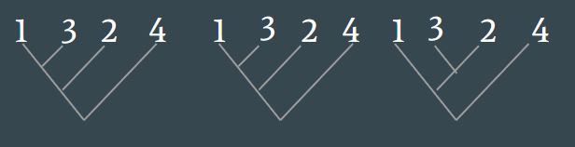
Maximum Parsimony Method
Constructs all possible trees (or possible placements on an existing tree) and looks for the tree which has the least number of substitutions or fewest evolutionary changes.
Count the # of changes to find the most parsimonious tree
MSA
Identify Informative Sites
Sample 1 A A C T A
Sample 2 A A C T C
Sample 3 A G C C A
Sample 4 A G G C C
Sample 1 A A C T A
Sample 2 A A C T C
Sample 3 A G C C A
Sample 4 A G G C C
Notes:
Given each alignment column, label the internal nodes to minimize the number of required substitutions.
After it aligns the sequences, it identifies informative sites, and then chooses the tree topology with the fewest total substitutions.
informative sites are those with two sites of characters and each happens at least twice.

Slide 11
Maximum Parsimony Example
Count the # of changes to find the most parsimonious tree
MSA
Identify Informative Sites
Sample 1 A A C T A
Sample 2 A A C T C
Sample 3 A G C C A
Sample 4 A G G C C
Sample 1 A A C T A
Sample 2 A A C T C
Sample 3 A G C C A
Sample 4 A G G C C
1
2
3
4
1
3
2
4
1
3
2
4
 | Position 2 | Position 4 | Position 5 | Total Changes
Tree 1 | 1 | 1 | 2 | 4
Tree 2
Tree 3
Notes:
After it aligns the sequences, it identifies informative sites, and then chooses the tree topology with the fewest total substitutions.

Slide 12
Maximum Parsimony Example
Count the # of changes to find the most parsimonious tree
MSA
Identify Informative Sites
Sample 1 A A C T A
Sample 2 A A C T C
Sample 3 A G C C A
Sample 4 A G G C C
Sample 1 A A C T A
Sample 2 A A C T C
Sample 3 A G C C A
Sample 4 A G G C C
1
2
3
4
1
3
2
4
1
3
2
4
 | Position 2 | Position 4 | Position 5 | Total Changes
Tree 1 | 1 | 1 | 2 | 4
Tree 2 | 2 | 2 | 1 | 5
Tree 3 | 2 | 2 | 2 | 6
Notes:
After it aligns the sequences, it identifies informative sites, and then chooses the tree topology with the fewest total substitutions.

Slide 13
Maximum Likelihood Method
Apply a probabilistic model with parameters to estimate the evolution from an ancestral sequence.
MSA
Parameters:
Iterate over many trees and parameters.
Sample 1 AACGT
Sample 2 ACCGG
Sample 3 ACCAA
Sample 4 AAGAG
tree topology, branch length, nucleotide frequencies, substitution rates, etc.
One tree that is most suitable based on observed sequences.
Notes:
You have sequences and a probabilistic model considering many different parameters. The model iterates over many possible tree topologies and chooses the best tree for how the observed data was produced. Essentially, you are getting one tree that has a higher probability that is preferred over the other possibilities. The best likelihood higher probability tree is the most suitable based on the observations.
Maximum likelihood methods are used in many different statistical analyses and can also be used as an optimality measure for choosing a preferred tree or set of trees. Essentially, you are getting one tree that has a higher probability that is preferred over the other possibilities. The best likelihood higher probability tree is the most suitable based on the observations. By employing a substitution model, ML calculates the total likelihood of ancestral sequences evolving to internal nodes and eventually to existing sequences. Likelihood of the model= best estimate is the set of parameter values which gives you the highest probability.

Slide 14
Maximum Likelihood Coin Toss Example
Data: coin toss 10 times (7 heads, 3 tails)
Model:
p for heads,
1-p for tails
P(heads)= n p^{h} (1-p)^{n-h}
h
Goal: Find the highest estimate for p that fits the data observed (h=7).
Source: https://www.youtube.com/watch?v=xDKUIegYpWM
Notes:
Maximum likelihood methods are used in many different statistical analyses and can also be used as an optimality measure for choosing a preferred tree or set of trees.
Given the model, what is the probability of your data/observations. What is the best estimate of the parameter values, find the parameter values that give you the highest probability of what we have observed. What is the value of p that gives us the highest likelihood of observing 7 heads.

Slide 15
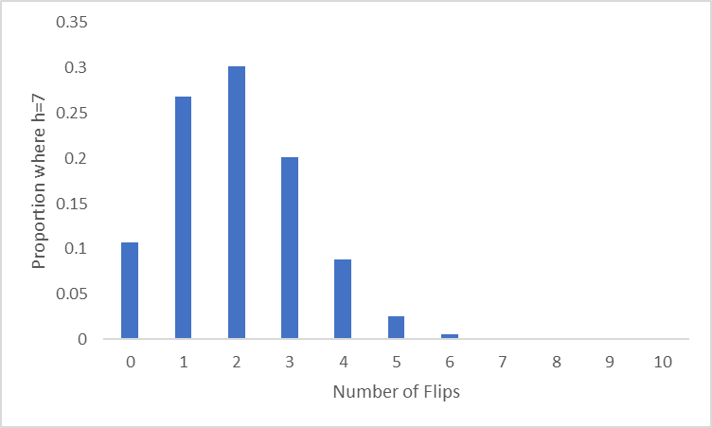
Maximum Likelihood Coin Toss Example
Let’s try p=.2. What is the probability distribution of outcomes?
Probability of observing 7 head tosses at p=.2 after 10 tosses? .001 (very low!)
Probability of success
Number of heads
Source: https://www.omnicalculator.com/statistics/coin-flip-probability

Slide 16
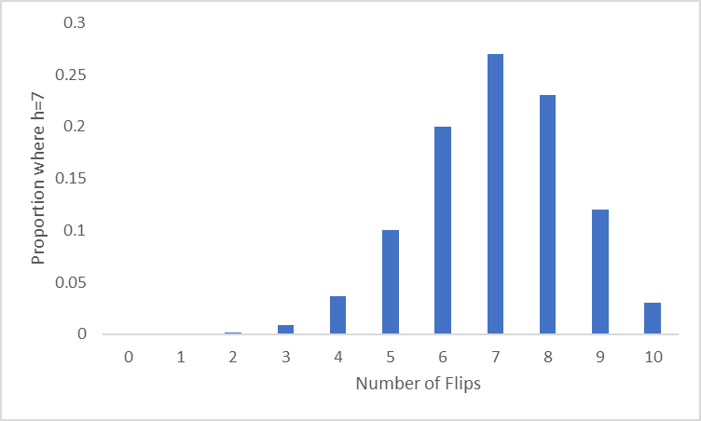
Maximum Likelihood Coin Toss Example
After multiple iterations trying different p values, you would find…
Probability of observing 7 head tosses at p=.7 after 10 tosses? .27 (the highest probability compared to all other p values)
Probability of success
Number of heads
Source: https://www.omnicalculator.com/statistics/coin-flip-probability

Slide 17
Maximum Likelihood Tree for Phylogenetic Trees
Observed data: MSA
Model: how one ancestral sequence has evolved into the MSA.
Parameters:
tree shape,
branch length,
nucleotide frequencies,
substitution rates, etc.
Goal: Iterate and perform a heuristic search for the maximum or best values for the parameters on the input data. Very computationally intense!
Notes:
Maximum likelihood methods are used in many different statistical analyses and can also be used as an optimality measure for choosing a preferred tree or set of trees. Essentially, you are getting one tree that has a higher probability that is preferred over the other possibilities. The best likelihood higher probability tree is the most suitable based on the observations.
Tries to calculate the probability at each site based on the observations and parameters to try to consider all the possible scenarios at which the tips of the tree could have evolved.
The likelihood for the full tree is the product of the likelihood at each site. There will have one tree that will have the maximum likelihood of all the trees.

Slide 18
Assess tree reliability using resampling techniques
Bootstrapping:
  Helpful to estimate the error in situations in which the underlying sampling distribution is either unknown or difficult to derive.
  The bootstrap approximates the underlying distribution by resampling from the original dataset (constructed by randomly sampling columns of the original alignment with replacement until an alignment of the same size is obtained). For each artificial dataset, a tree is constructed and the proportion of each clade among all the bootstrap replicates is computed. This proportion is taken as the statistical confidence supporting the monophyly of the subset.
Jackknifing:
  Helpful to evaluate the reliability of specific clades.
  The jackknife generates replicate data sets by randomly purging half of the sites from the original alignment. Trees are reconstructed for each replicate and the proportion of each clade among all the bootstrap replicates can be considered a measure of robustness of the monophyly of the taxa subset.
Notes:
Resampling techniques involve generating a series of sequence alignments by sampling columns from the original sequence alignment. Each of these alignments (known as pseudoreplicates) is then used to build an individual phylogenetic tree. A consensus tree can then be constructed by combining information from the set of generated trees or the topologies that occur can be sorted by their frequency.

Slide 19
Picking a tree method depends on the question you are asking.
Maximum Parsimony (i.e. UShER)
Best for understanding which sequences are most closely related to yours.
Pro: easy and fast!
Con: limited in the types of questions you can answer.
Maximum Likelihood (i.e. Nextstrain)
Best for identifying transmission dynamics, doing phylogeographic studies, and making inferences related to time.
Pro: can answer many different questions.
Con: can be slow, require command line, and be computationally intense.

Slide 20
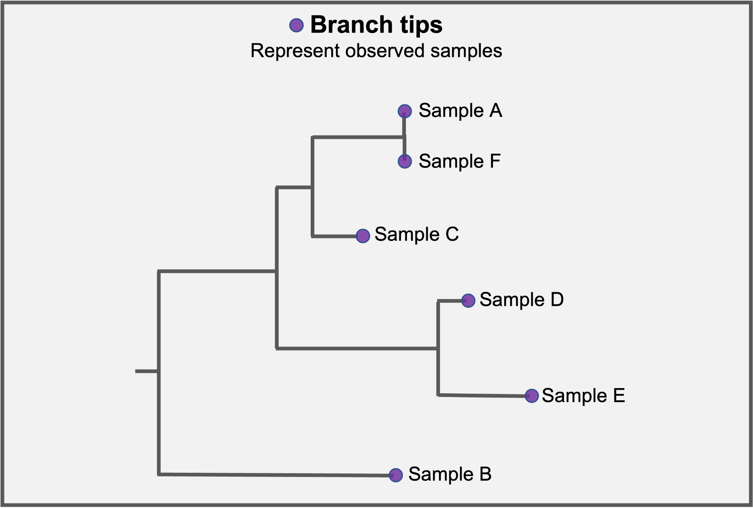
Interpreting a tree
Source: https://help.czgenepi.org/hc/en-us/articles/9009239323156-Genomic-epi-basics-Practice-reading-phylogenetic-trees

Slide 21
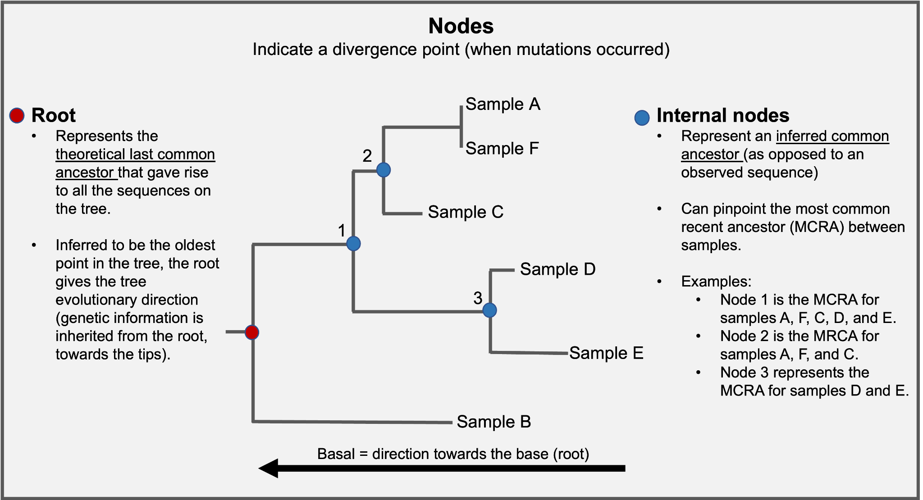
Interpreting a tree
Source: https://help.czgenepi.org/hc/en-us/articles/9009239323156-Genomic-epi-basics-Practice-reading-phylogenetic-trees

Slide 22
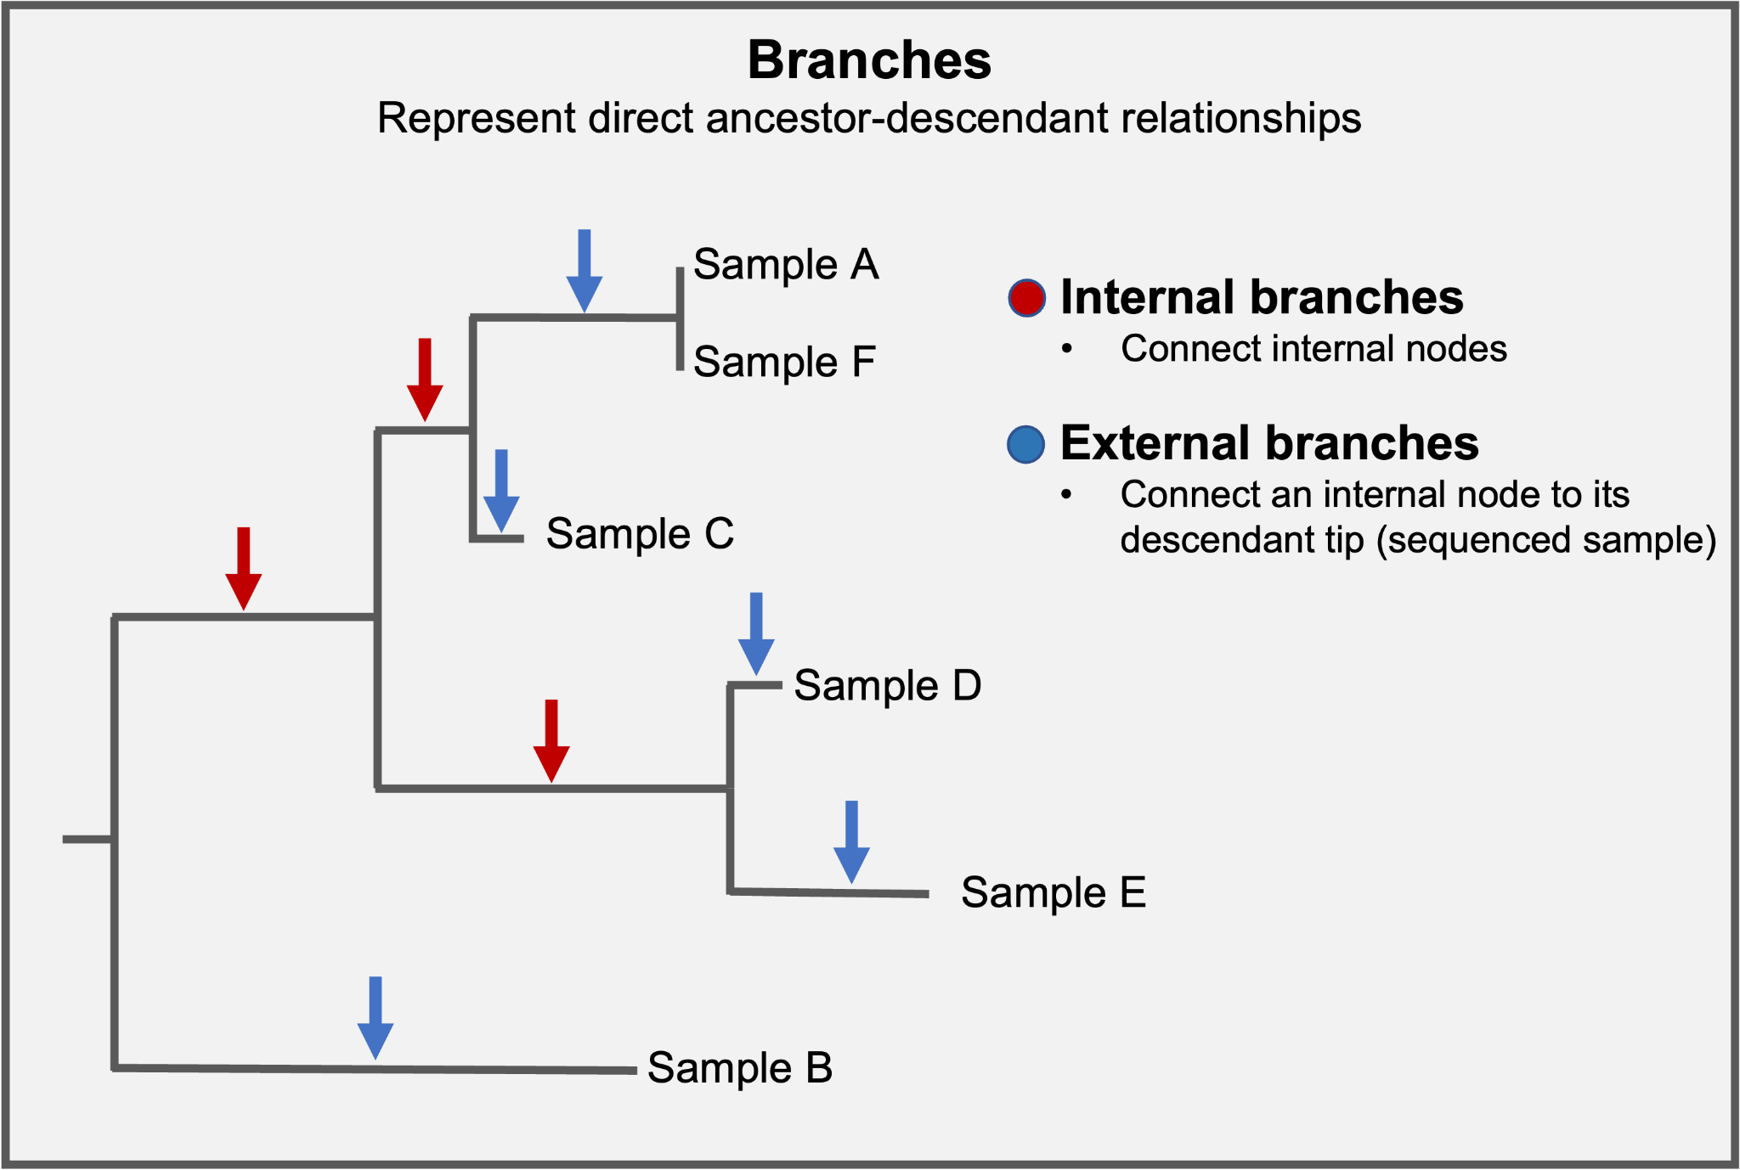
Interpreting a tree
Source: https://help.czgenepi.org/hc/en-us/articles/9009239323156-Genomic-epi-basics-Practice-reading-phylogenetic-trees

Slide 23
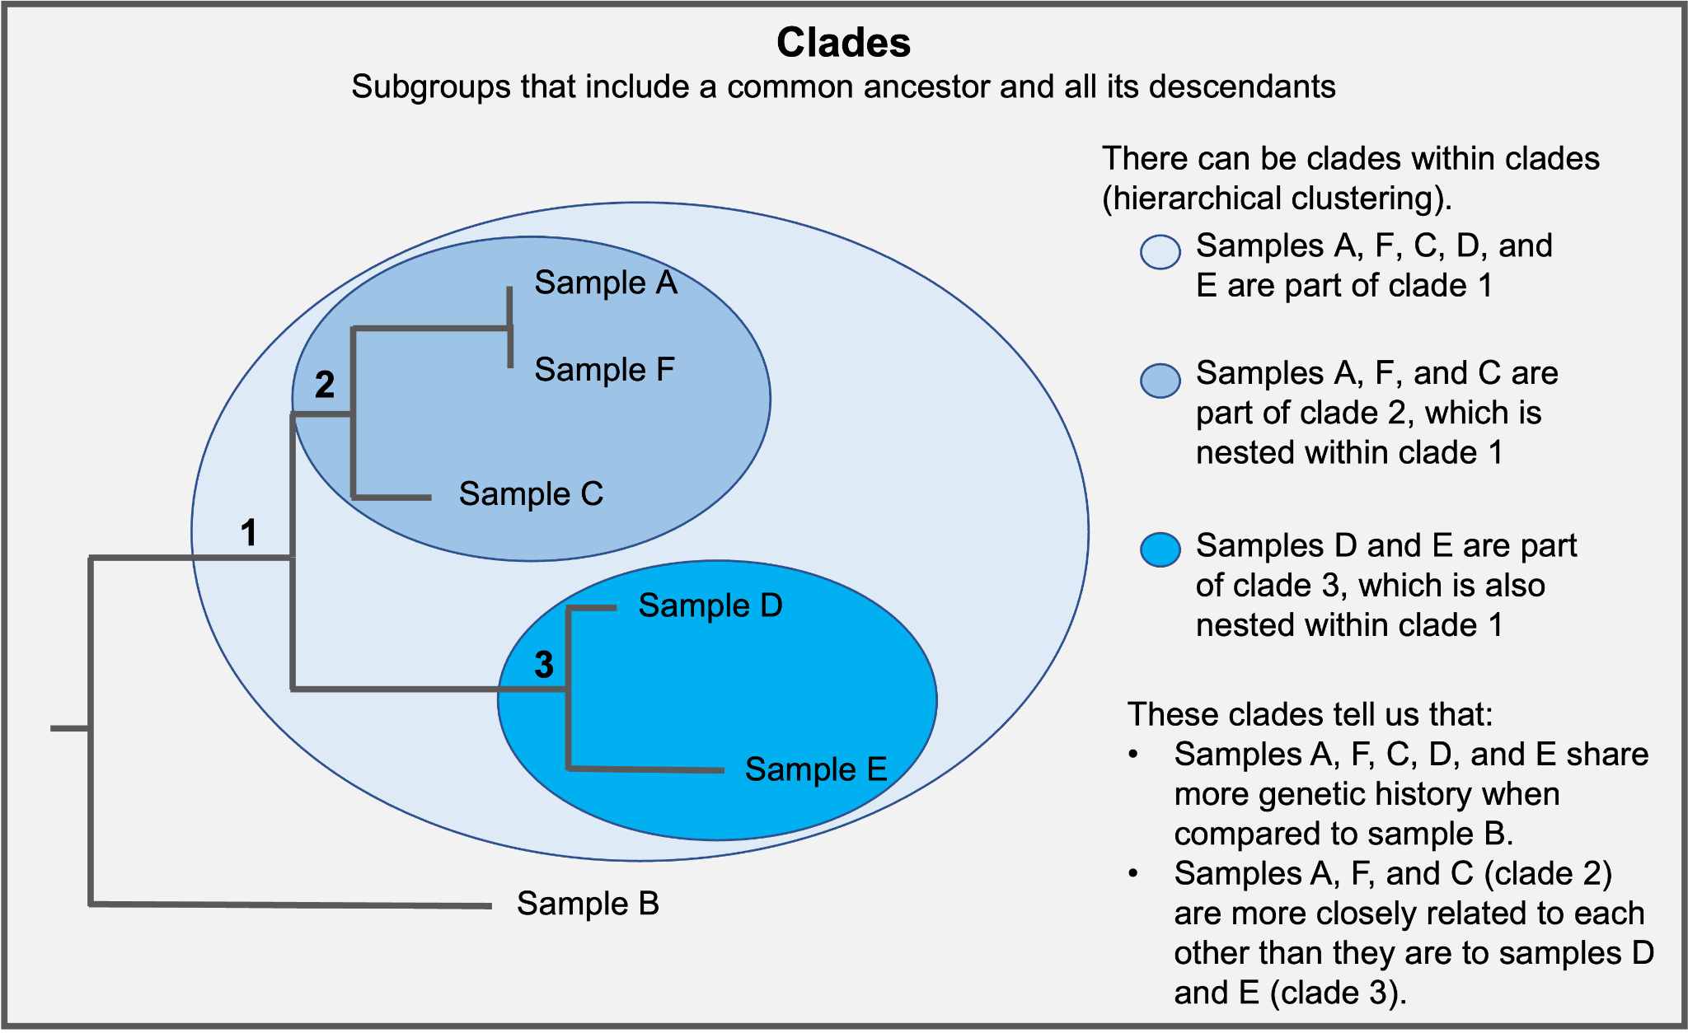
Interpreting a tree
Source: https://help.czgenepi.org/hc/en-us/articles/9009239323156-Genomic-epi-basics-Practice-reading-phylogenetic-trees

Slide 24
Interpreting the Y-axis
Y-axis is meaningless, so branches in the tree can be rotated without altering the meaning of the diagram.
T3456C, A6789G, C1234G
A
C
B
B
C
T3456C, A6789G, C1234G
A
Notes:
For beginners and advanced users alike, interpreting a phylogenetic tree can present a challenge because the y-axis in a phylogenetic tree is meaningless. It is used to lay out all of the tips so they do not overlap - the proximity of any two tips along the y-axis does not indicate anything about their relatedness. This also means that the branching in a phylogeny can be rotated without altering the meaning of the diagram in any way. Because phylogenies sacrifice an entire dimension for clearly laying tips, there is also a limit on how much information can be packed into simple phylogenetic tree figures

Slide 25
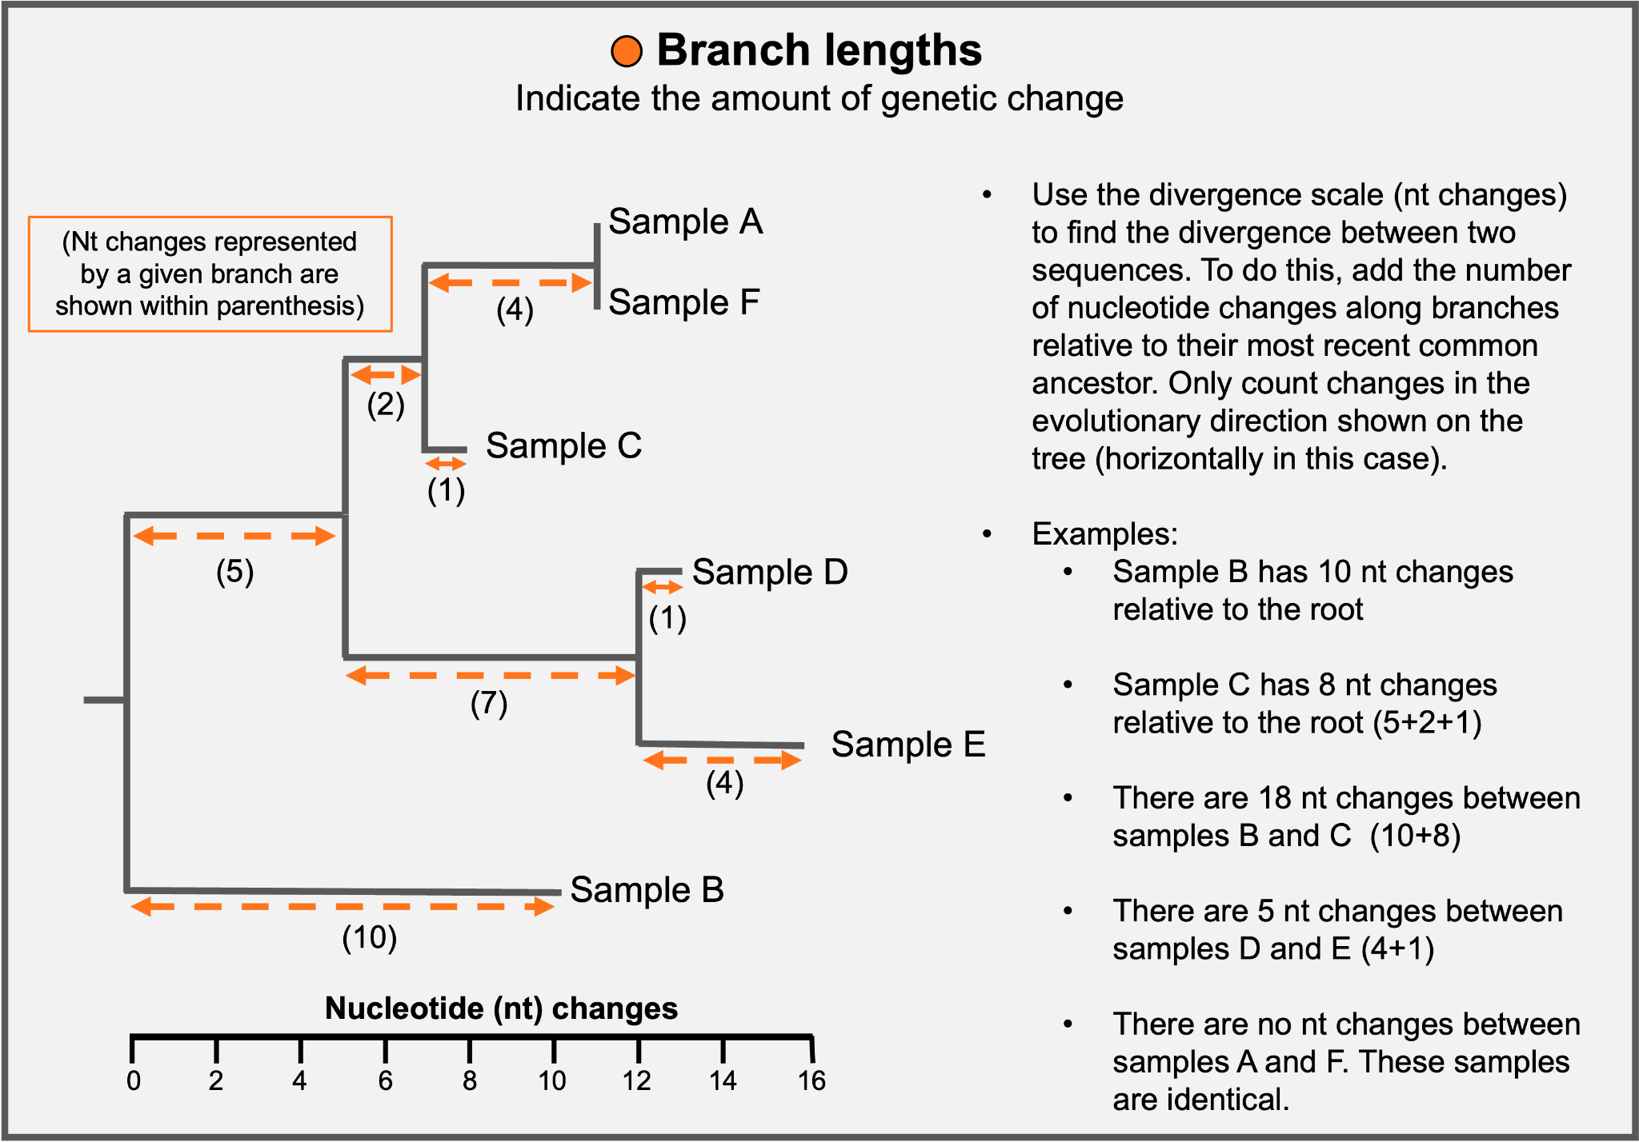
Interpreting branch lengths (divergence tree)
Source: https://help.czgenepi.org/hc/en-us/articles/9009239323156-Genomic-epi-basics-Practice-reading-phylogenetic-trees
Notes:
When looking at a genetic divergence phylogenetic tree, you will typically see that branch lengths are scaled in terms of a normalized number of substitutions per site in the genome. For increased interpretability, branches in genetic divergence trees may also be scaled in terms of total number of substitutions observed across the entire genome. Either way, both of these scalings represent an amount of sequence change that has occurred. the length of a branch leading to a tip is scaled according to the number of mutations that are observed within that sample’s sequence, but not in other samples in the tree. If the numbers of mutations that are unique to a sample are very large, it is often an indicator of a sequence quality issue (for example, a sequencing error, or a bioinformatics issue with genome assembly).

Slide 26
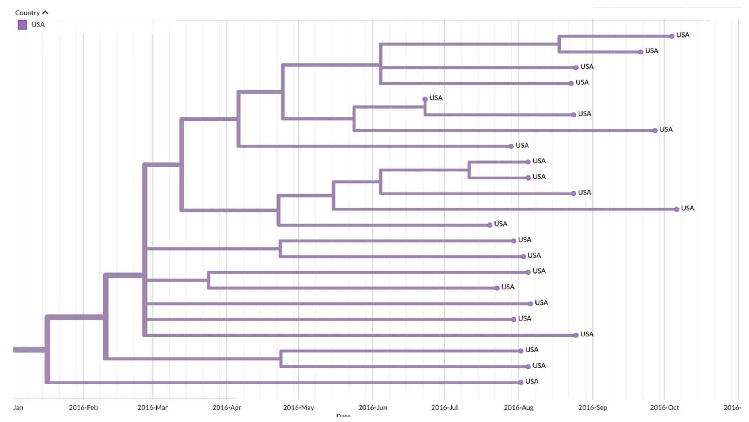
Interpreting time trees
X-axis measures divergence in time that has passed since the root and the position of tips is given by the date that a sample was collected from an individual.
https://help.czgenepi.org/hc/en-us/articles/6238581606932-Module-6-Using-evolutionary-rates-to-infer-time-trees-
Notes:
In a temporally-resolved tree, the x-axis will be given in calendar time (or absolute time), rather than in the amount of divergence.
The x-axis position of tips is given by the date that a sample was collected from an individual. The sampling date of a sample is usually specified in the metadata attached to a sample.

Slide 27
Time trees help us estimate when sequences emerged.
The x-axis position of internal nodes represents when we infer that those inferred ancestral viruses likely circulated.
https://help.czgenepi.org/hc/en-us/articles/6238581606932-Module-6-Using-evolutionary-rates-to-infer-time-trees-
Notes:
The x-axis position of internal nodes represents when we infer that those inferred ancestral viruses likely circulated. Typically those positions will be specified with a point estimate of the date, and a confidence interval around the point estimate. Estimating the inferred age of the samples we did not sequence. “When did these sequences emerge?” Do an example from the slide.

Slide 28
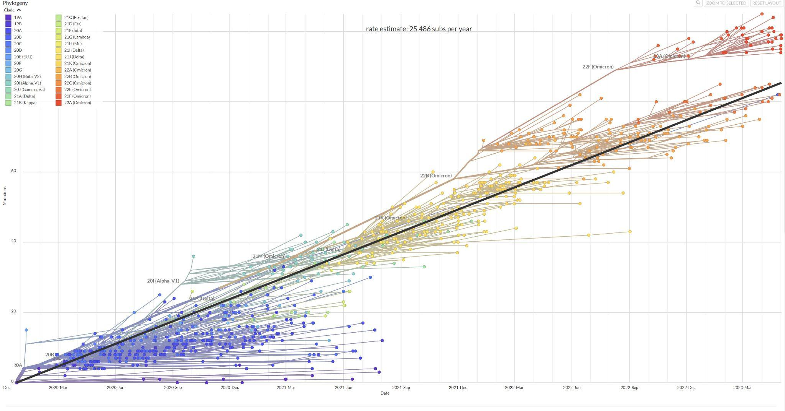
Molecular clocks help us go from a divergence tree to a time tree
Creating a time tree requires a molecular clock to translate the genetic divergence data into temporal information. We infer a molecular clock via root-to-tip distance plots.
Rate Estimate: 25 subs per year
Notes:
You can calculate a root-to-tip distance for a sample by summing up the branch lengths between the root of the tree and a tip.
Molecular clock, the evolutionary rate, or the substitution rate are all synonyms that describe this concept. These are different from the intrinsic mutation rate of a pathogen.
Estimates of molecular clocks are improved by serial sampling, which means that genomic sequence data are collected consistently over time, rather than in large batches at once.
What is shown here is a strict clock. It is considered a strict clock because it fits the same evolutionary rate to all branches in the tree.
The rate estimate comes from the slope of a regression line through a scatter plot of the root-to-tip distances plotted as a function of sampling date.

Slide 29
Evolutionary rates tell us how fast the molecular clock is “ticking”
Evolutionary rates describe the number of substitutions we observe at the consensus level over time.
Rate Estimate: 25 subs per year
Source: https://help.czgenepi.org/hc/en-us/articles/6238561735316-Module-5-Interpreting-and-working-with-evolutionary-rates-
Notes:
The speed at which mutations are observed over time is known as the evolutionary rate (how fast is the molecular clock ticking).
The evolutionary rate represents the amount of genetic divergence we expect to accrue over a certain amount of time on average.
It can be given in as a non-normalized (as it is here) or normalized rate (if you divided by the genome to get the # of substitutions per nucleotide site per year). Non-normalized is easier to interpret.
And, because it is the # of substitutions we observe it can vary by dataset, even for the same pathogen species. the rate at which we see substitutions depends on more than just the rate at which mutations occur (which is intrinsic to the pathogen); it also depends on factors such as the timescale over which you sample and the strength of selection. (too much, you capture deleterious mutation that usually are purged and would be mixed). If sampling over longer timescale you have time to remove these and estimate a slightly lower rate.

Slide 30
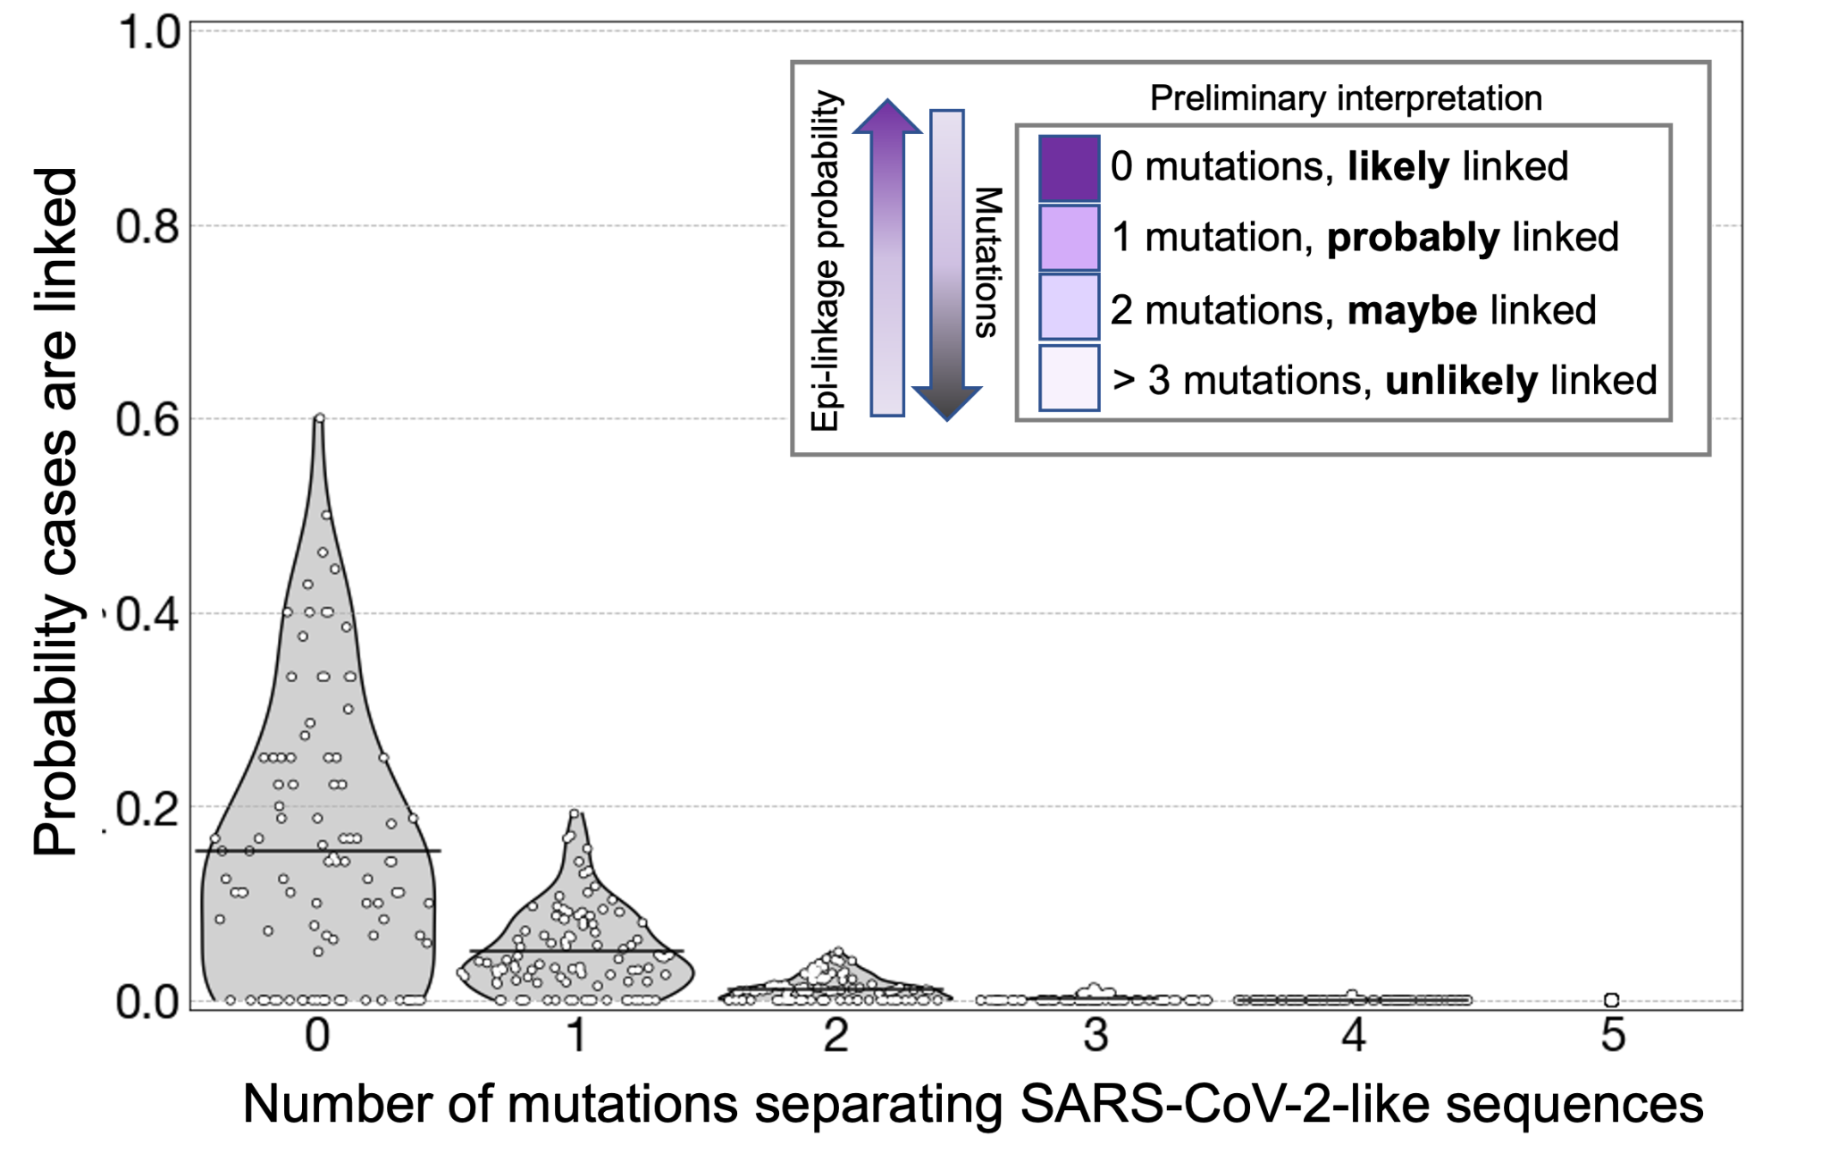
Using evolutionary rates to assess relatedness between cases
Evolutionary rates can help us estimate how much transmission has passed among cases with a few mutations apart from one another.
In order to assess relatedness, epidemiologists often set a threshold for when enough mutations have occurred that they can be considered unlinked.
Notes:
Coming back to ruling linkage out, what is the threshold at which there are “enough” mutations separating sequences that you can consider them to be unlinked? Like many things, the answer is “it depends”. And it depends on both the evolutionary rate of your pathogen of interest, and average length of the serial interval between two cases in a direct infection. Given that both these variables have distributions, it is best to think about sequence divergence and case linkage probabilistically. In the figures below we show probability distributions for whether cases are directly-linked given that their consensus genome sequences are separated by x mutations. We show these plots for two different (theoretical) viral pathogens with different evolutionary rates and different genome lengths to illustrate how thresholds can change depending on the pathogen and the rate of transmission.

Slide 31
Using evolutionary rates to assess relatedness between cases
A
SARS-CoV-2 Example:
B
Evolutionary rate:
~25 mutations per year x 1 year /12 months
~2 mutations per month
~1 mutation every 2 weeks
Serial interval between direct infections:
~5 days
C
D
0 1
About 2 weeks have passed between Samples A-C and Sample D. And, they could be separated by 1 to 2 transmission events. These samples are likely related, but can we say anything about directionality?
Notes:
Coming back to ruling linkage out, what is the threshold at which there are “enough” mutations separating sequences that you can consider them to be unlinked? Like many things, the answer is “it depends”. And it depends on both the evolutionary rate of your pathogen of interest, and average length of the serial interval between two cases in a direct infection. Given that both these variables have distributions, it is best to think about sequence divergence and case linkage probabilistically. In the figures we show probability distributions for whether cases are directly-linked given that their consensus genome sequences are separated by x mutations.

Slide 32
Common misinterpretations of phylogenetic trees
A
B
C
Misconception: A phylogenetic tree = A transmission diagram
Were cases A, B, C, and D all exposed to the same source? And, the minority variant transmitted to D?
D
0 1
A
Unsequenced source
B
C
D
Source: https://alliblk.github.io/genepi-book/index.html
Notes:
Be careful about directionality!
Let’s walk through an example to illustrate this principle. Imagine you have two cases of a viral respiratory disease from the same household, with symptom onset dates roughly 3 days apart. Given the shared setting that these two people live in, and the timing of their infections, it seems likely that this pair of cases would represent an instance of household transmission, in which the case with the earlier symptom onset date likely infected the person with the later symptom onset date. Having genomic sequencing capacity in your public health lab, you take those two case’s diagnostic specimens and sequence the viral genomes. You look at the consensus genomes and see that despite these cases coming from the same household, the sequences are quite divergent from each other. Given the evolutionary rate of this respiratory virus, you estimate that you would need roughly 6 months worth of transmission to accumulate the total number of nucleotide differences observed between those two sequences. Furthermore, the two cases’ sequences are more related to other genome sequences collected in the area than they are to each other. You conclude that despite the shared living space and the timing of symptom onset, these two cases are not actually linked, and that it’s more probable that they were each independently infected in different settings outside the home. The divergence between their consensus genomes allows you to easily rule out linkage between them.
In contrast, imagine you take that same household pair, and they have identical genome sequences. Their infections are likely related, but you can’t tell from the genomic data who infected whom. Moreover, you can’t actually tell whether the transmission is even between these two cases. For instance, the household pair could both have been infected by a friend at a party they both attended, and they just had slightly different symptom onset rates. With identical genome sequences you can tell that the cases are likely related, but you often won’t know exactly how related, and it’s highly unlikely that you’ll be able to rule in a direct transmission event without pulling in additional sources of information.

Slide 33
Common misinterpretations of phylogenetic trees
A
B
C
Misconception: A phylogenetic tree = A transmission tree
Were cases A, B, C, and D all exposed to the same source? And, the minority variant transmitted to D?
Did case A (for example) infect B and C, and then case C infected D?
Be careful with directionality!
D
0 1
B
A
C
D
5 days
5 days
Source: https://alliblk.github.io/genepi-book/index.html
Notes:
Be careful about directionality!
Let’s walk through an example to illustrate this principle. Imagine you have two cases of a viral respiratory disease from the same household, with symptom onset dates roughly 3 days apart. Given the shared setting that these two people live in, and the timing of their infections, it seems likely that this pair of cases would represent an instance of household transmission, in which the case with the earlier symptom onset date likely infected the person with the later symptom onset date. Having genomic sequencing capacity in your public health lab, you take those two case’s diagnostic specimens and sequence the viral genomes. You look at the consensus genomes and see that despite these cases coming from the same household, the sequences are quite divergent from each other. Given the evolutionary rate of this respiratory virus, you estimate that you would need roughly 6 months worth of transmission to accumulate the total number of nucleotide differences observed between those two sequences. Furthermore, the two cases’ sequences are more related to other genome sequences collected in the area than they are to each other. You conclude that despite the shared living space and the timing of symptom onset, these two cases are not actually linked, and that it’s more probable that they were each independently infected in different settings outside the home. The divergence between their consensus genomes allows you to easily rule out linkage between them.
In contrast, imagine you take that same household pair, and they have identical genome sequences. Their infections are likely related, but you can’t tell from the genomic data who infected whom. Moreover, you can’t actually tell whether the transmission is even between these two cases. For instance, the household pair could both have been infected by a friend at a party they both attended, and they just had slightly different symptom onset rates. With identical genome sequences you can tell that the cases are likely related, but you often won’t know exactly how related, and it’s highly unlikely that you’ll be able to rule in a direct transmission event without pulling in additional sources of information.

Slide 34
Phylogenetic trees are more useful for ruling cases out using a threshold, than ruling cases in.
Can we rule out any cases for the SARS-CoV-2 outbreak shown on the phylogenetic tree on the right?
Yes! Too much time has passed for these cases to be considered directly linked.
A
B
C
D
0 1 2 3 4
Source: https://alliblk.github.io/genepi-book/index.html

Slide 35
Summary
Maximum parsimony and maximum likelihood methods are robust and efficient tree building techniques for genomic epidemiology studies.
Divergence trees can be translated into temporally resolved trees using molecular clocks. These trees estimate an evolutionary rate, which helps assess relatedness between cases.
Phylogenetic trees provide explicit and implicit information, some of which can be misleading. Be cautious about assigning directionality and help your audience with the interpretation.

